Slide 1
Lecture 6- Evolution Basics
PT 1- Tenants & Misconceptions
PT 2- Evolutionary Processes

Slide 2
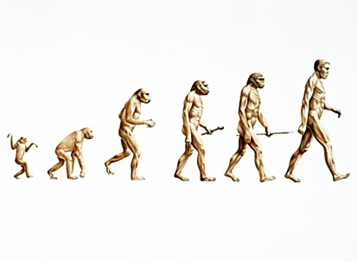
PT 1- Tenants & Misconceptions
Evolution- Descent w/ modification
Changes in life through time

Slide 3
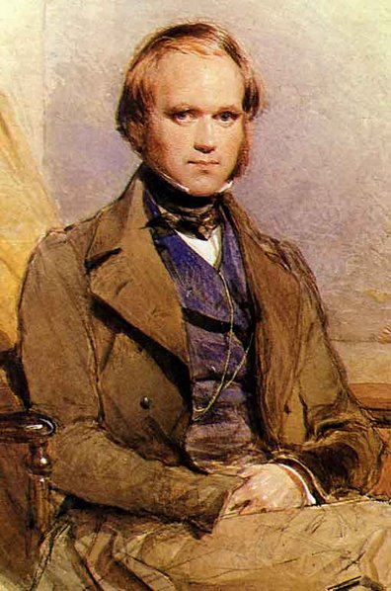
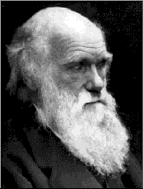
Darwinian Theory
On the Origin of Species by Means of Natural Selection 1859
Accumulated data for over 20 years
Fossils (he traveled across the world)
(Artificial Selection) Breeding
Malthusian Dilemma (population size and resource competition)
Economist in the UK, late 1700s early 1800s, looking at resources when a population grows.
How do you keep feeding everybody?
Population grows at an exponential growth, grow rapidly
Basic resources will start to go down, in a linear fashion.
Alfred Wallace reached same conclusion:
some natural process enabled only certain individuals to survive = Natural Selection

Slide 4
Natural Selection
1- Individuals posses heritable traits
eye color, lactose intolerance
2- Some variants provide a selective advantage
better at finding food
Attract more mates
avoid predation
3- Not all young survive long enough to reproduce
Those w/ favorable traits are most likely to survive and pass on their traits
Thus, NOT a random process (it’s very systematic)
Other misconceptions…

Slide 5
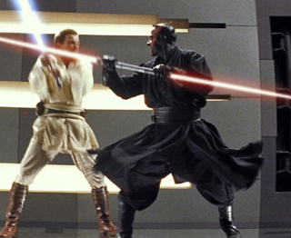
#1- ‘Survival of the Fittest’
Misleading b/c reproduction, not mere survival, is central to natural selection
Survive but don’t breed = traits not passed on
Not all ‘fit’ individuals will survive
Those w/ the favorable traits have a higher probability of surviving to reproductive age

Slide 6
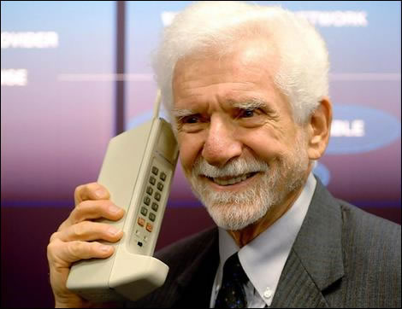

#2- ‘Complexity’
Features evolve over time, but were not always used in the same manner
Complex features (wings, eyes) had intermediate stages
May seem useless compared to ‘the final product’, but intermediates were useful AT THAT TIME
Can’t compare when they did not exist at the same time.

Slide 7
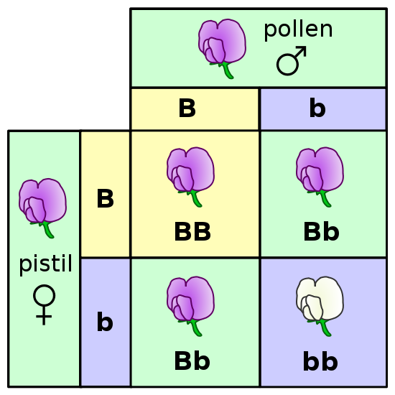
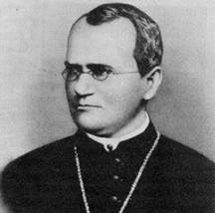
Genetics
Mendel experiments, not recognized until 1900
He was a monk, he was just working with plants in the garden.
Provided the means for inheriting traits
Genes control traits
Can be recessive; trait might still be there but masked by the more dominant trait.
Not lost/blended when masked by a dominant trait

Slide 8
Variation
Sources:
1-Sexual reproduction (half from each parent)
Each individual offspring will have a unique half from each parents = variation
2- Mutation (copy of the genes that is not quite a copy)
Mutations may be helpful, neutral, or harmful
May become helpful if environmental factors change (white/black moths example)
3- Genetic Drift- isolated populations have a limited gene pool, so they will evolve in different ways rel to a larger pop with a more diverse gene pool

Slide 9
PT 2- Evolutionary Processes
We are trying to figure out when new species appear and when species die out.
Speciation- Creation of new species, population can produce viable off-springs.
2 general ways:
1- Phyletic Gradualism : species are always trying to gradual change into another over a long period of time. Like uniformatarism.
2- Punctuated Equilibrium: actually species are stable entities in long periods of time but there are certain event will force it to rapidly change into another species. Like cataspphsim.
Both happen in nature.

Slide 10
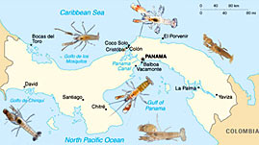
Speciation Models
1- Allopatric Speciation (allo: different patric: homes)
Species got divided up into two different homes
How did they end up in different places?....
Land bridge came up and created two different home. The population got split up and had to go on their own.
Vicariance example

Slide 11
Allopatric Models
1a- Vicariance
Passive model (physical barrier)
Both populations evolve different features/ along new lines
TIME 1
TIME 2
TIME 3
pop A’
Species B
Species A
RIVER
RIVER
pop A’’
Species C

Slide 12
Allopatric Models
1b- Dispersal
Active migration by part of the population
Population that left went into a new environment and now rapidly starts to change and evolve. Only one new species was produced.
Less common
TIME 1
TIME 2
TIME 3
Species A
Species B
RIVER
RIVER
RIVER
Species A
Species A
Species A

Slide 13
Speciation Models
2- Sympatric Speciation (“same homes”)
Population subgroup not physically separated, but becomes reproductively isolated
All the critters are living in the same space but some might not reproduce with the pool.

Slide 14

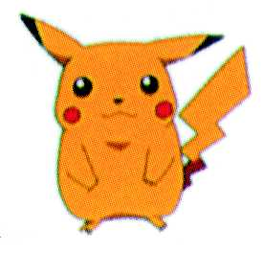
Example- Sympatric Speciation- Time 1
Notes:
Yellow pikachu wants yellow
Orange one wants orange one
No land bridge, same home
Reproductively they are isolated to the gene pool to their preference.

Slide 15
Example- Sympatric Speciation- Time 2

Slide 16
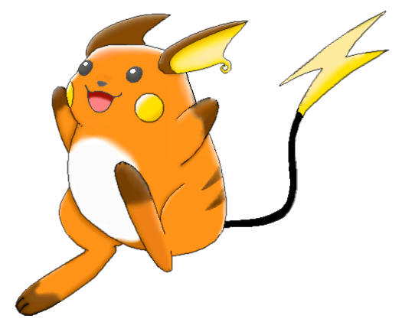
Example- Sympatric Speciation- Time 3

Slide 17
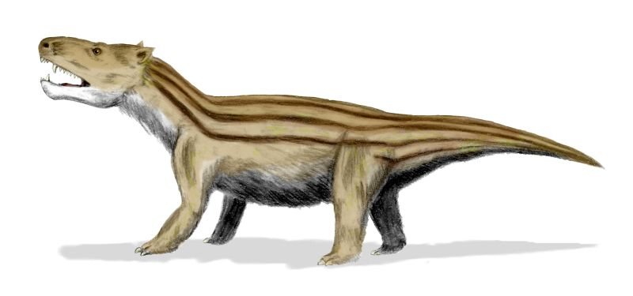
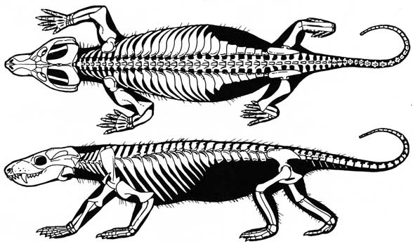
Other Evolutionary Processes
Divergent Evolution- one ancestral species gives rise to very diverse descendents
Ex- all mammals come from cynodonts
Descendants will be noticeably different from the ancestral form
Notes:
WE ARE DESCENDANTS OF CYNODONTS

Slide 18
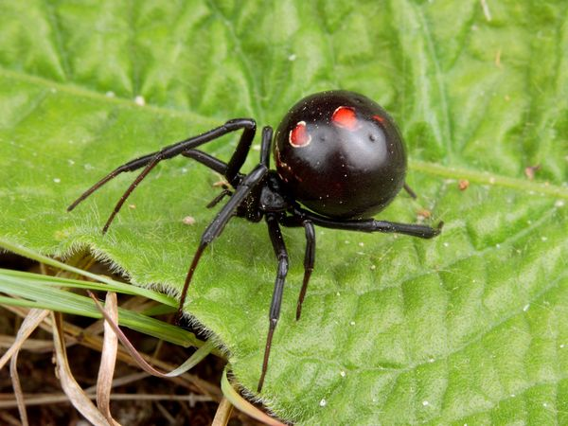
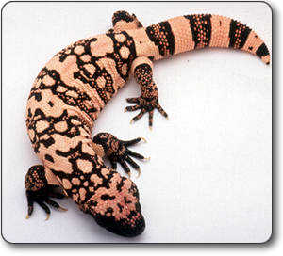
Evolutionary Processes
Convergent Evolution- Very different species of the biologic family but develop similar traits
Results from species dealing with similar selection pressures
Ex: Arachnids and Vertebrates
Both black and red: using the coloration for the same reason = protection.

Slide 19
Convergent Features
Homologues- derivation from a common ancestral feature
Basic similarities exist
Diff b/c evolved differently in each group
Analogues- same use, but not very closely related
Details are often different.

Slide 20
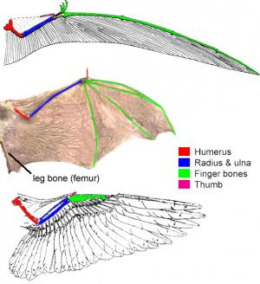
Homologue or Analogue?
Q1: forelimbs of cats, humans, and horses
Homologue
Q2: wings of birds, bats, and pterosaurs
All wings but no common ancestry, detail show that their wings are all different.
Analogue

Slide 21
Evolutionary Processes
Parallel Evolution- Closely related species evolve similar traits independently
So the ancestors were similar to each other, and so are the descendants
Vs convergent evolution, where the ancestors were not necessarily similar to each other.
Also results from species dealing with similar selection pressures
EX: Two different types of spiders with the same color pattern
But not convergent evolution

Slide 22
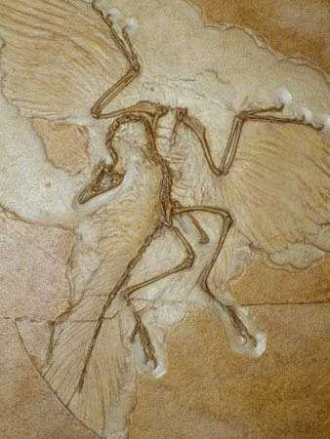
Evolutionary Processes
Mosaic Evolution- Not all features of a group evolve simultaneously
Ex- early birds had wings + teeth & long tails
Combination of old and new traits, but doesn’t mean it had to have all the modern traits all at one time to succeed
Modern birds don’t have teeth or tails.
Thus, species may contain both primitive and advanced (i.e. a mosaic of) traits

Slide 23
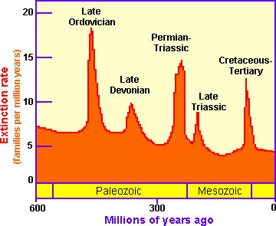
Extinction
Background Extinction
At any point in time there are species going extinct.
Est 1 species / 4 yrs
Mass Extinction
Several extinction times
In the past.

